Slide 1
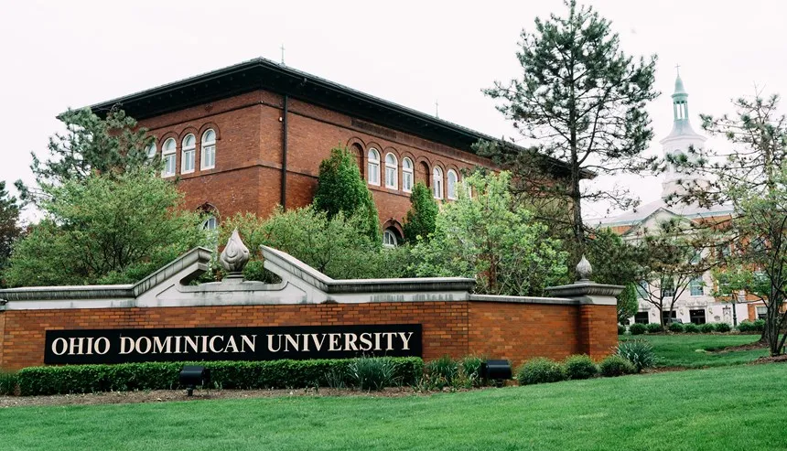

Streamlining Ancestry: A Lightweight Document Processing Pipeline for Historical Document Data Extraction
Researcher: Merrick Shorter
Faculty Advisor: Dr. Nishatul Majid

Slide 2
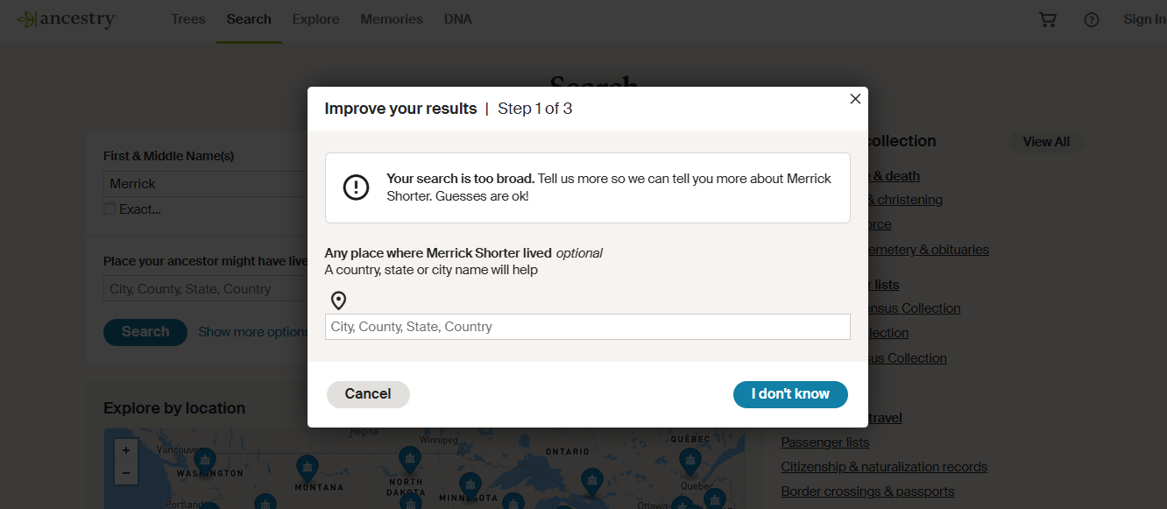
Background on Historical Documents
Digitalization
Massive Datasets
Ancestry, Familysearch
Solution: Indexing for easier search
Method
Data Extraction
Manual takes forever
How do we do that?
Artificial Intelligence

Slide 3
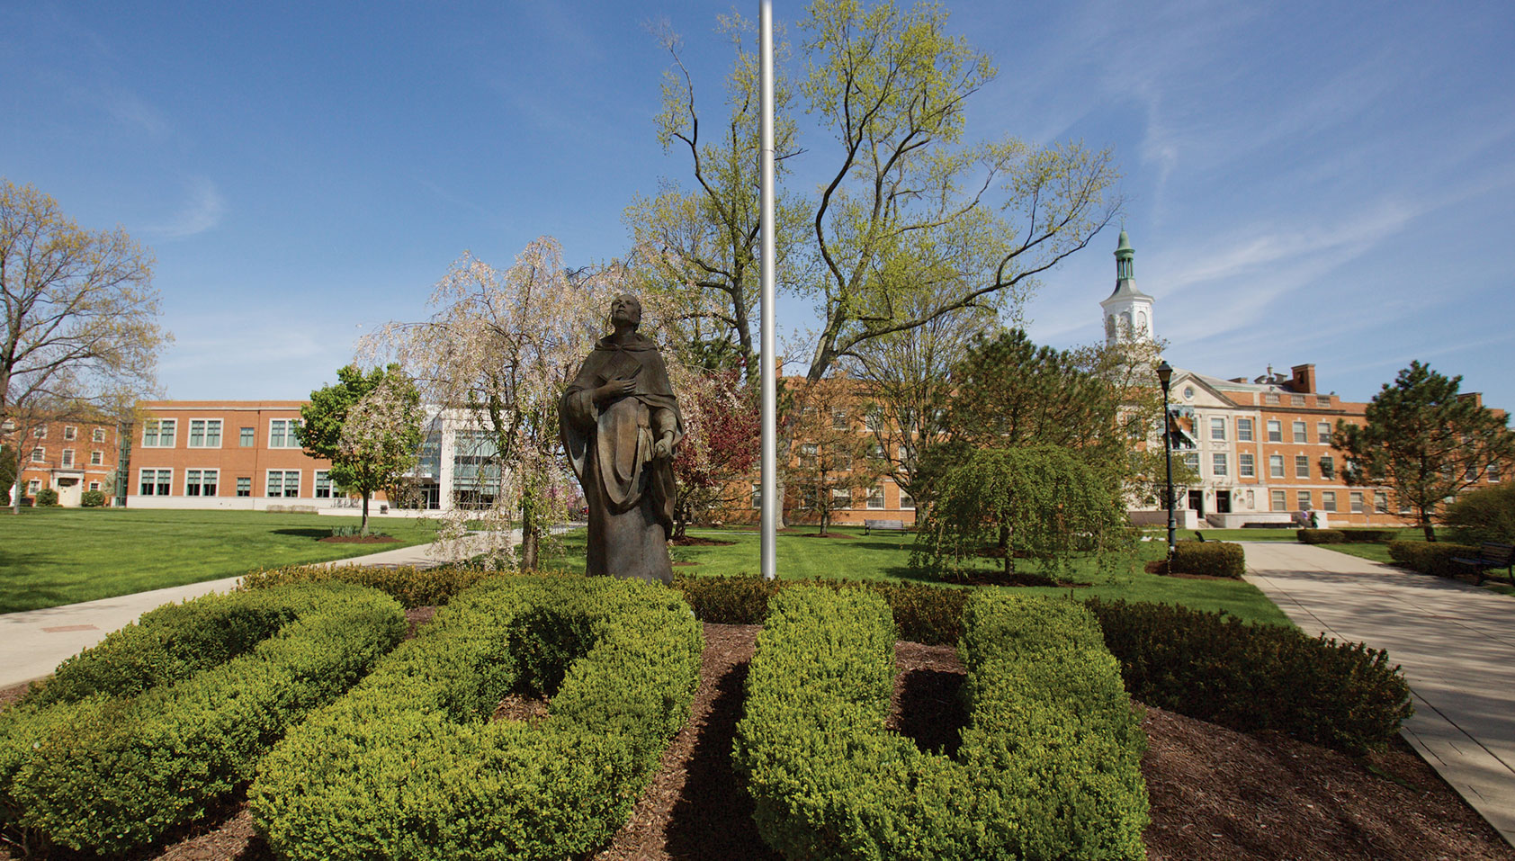
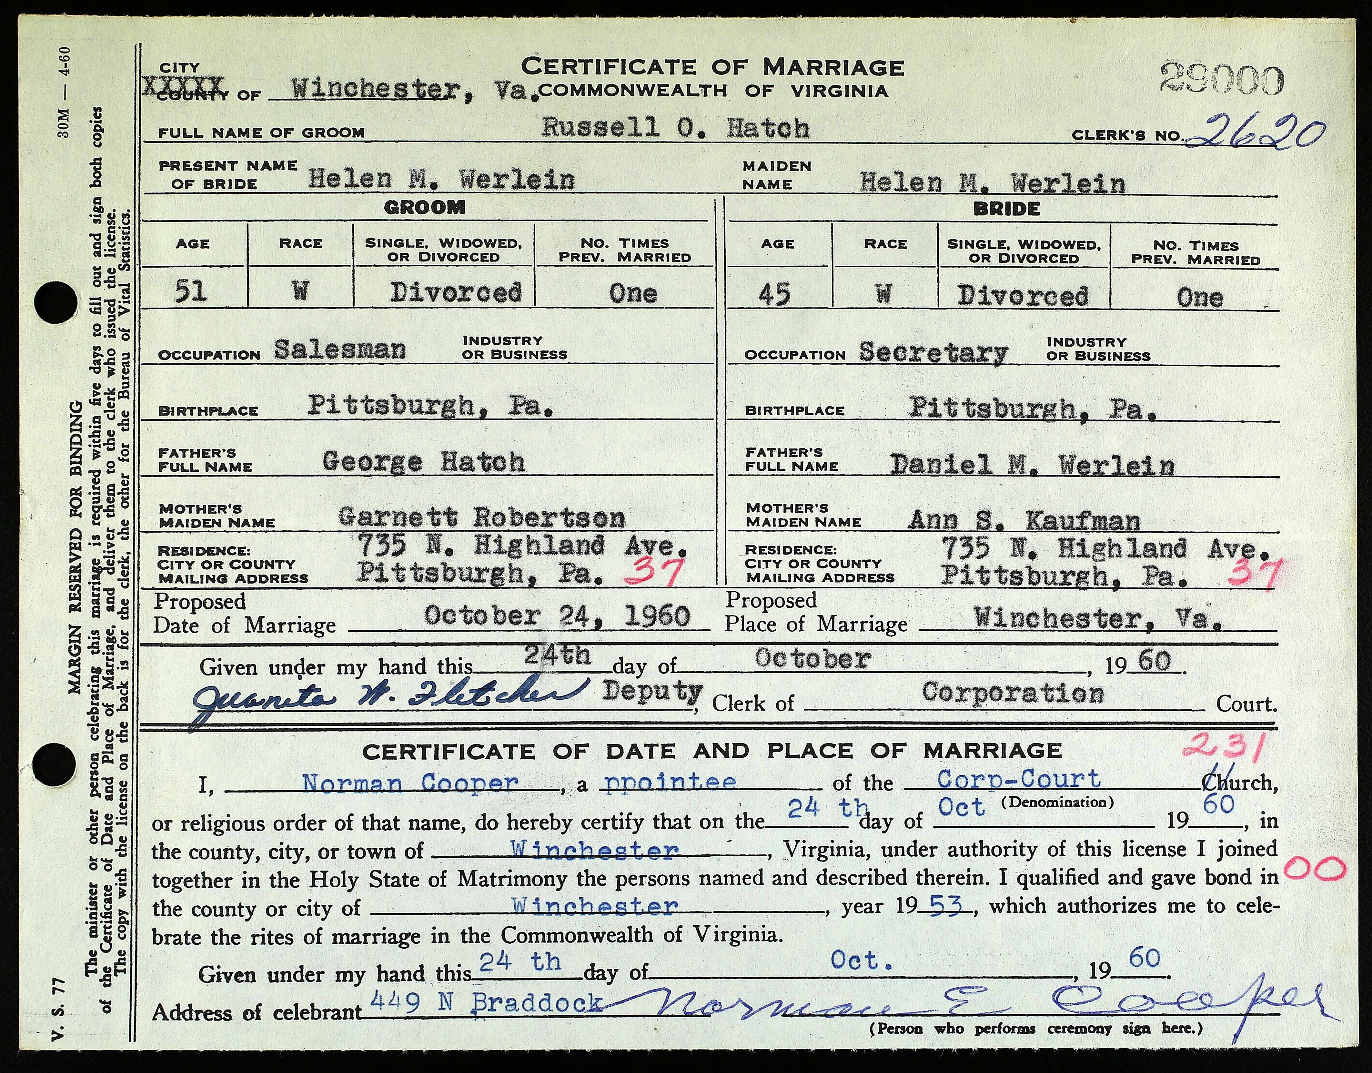
Where we are
Dataset
Virginia Marriage Certificates October 1960
Trying to detect machine printed consistent fields

Slide 4
Goals of the research
Create a system to achieve the following
End to end
Accurate data extraction
Lightweight
Require little training data

Slide 5
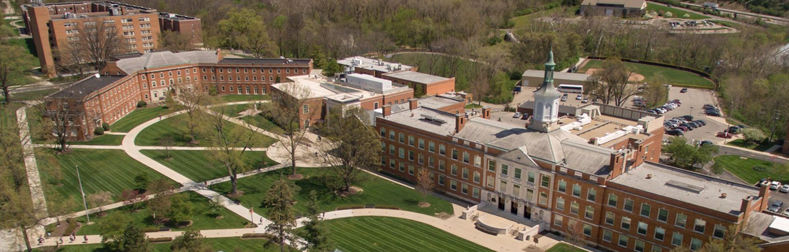
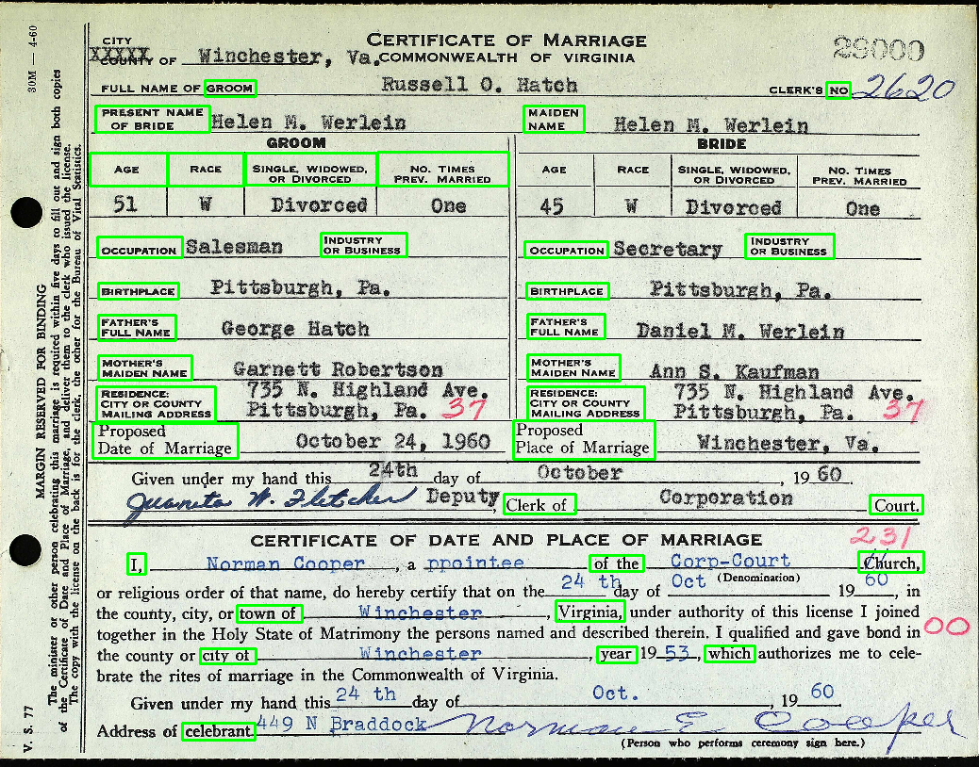
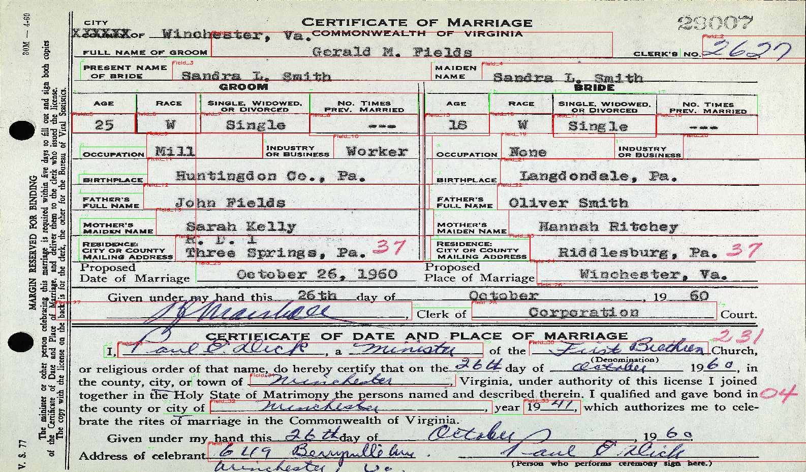
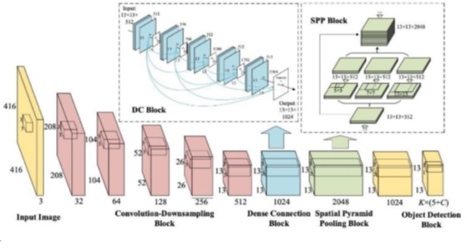
Framework
Object detection
Yolov8
Offset Math

Slide 6
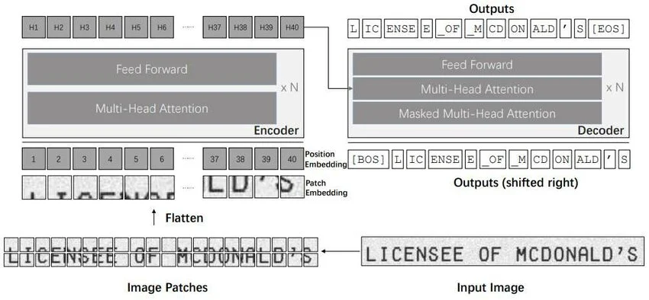


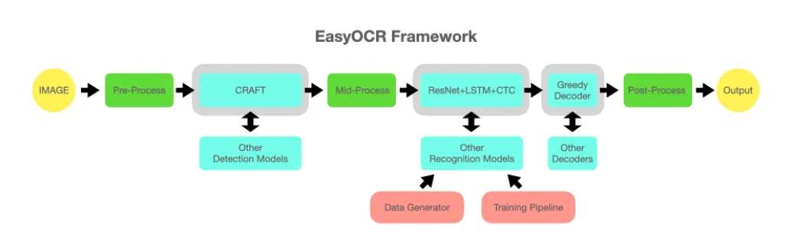
Framework
OCR
EasyOCR
TrOCR

Slide 7
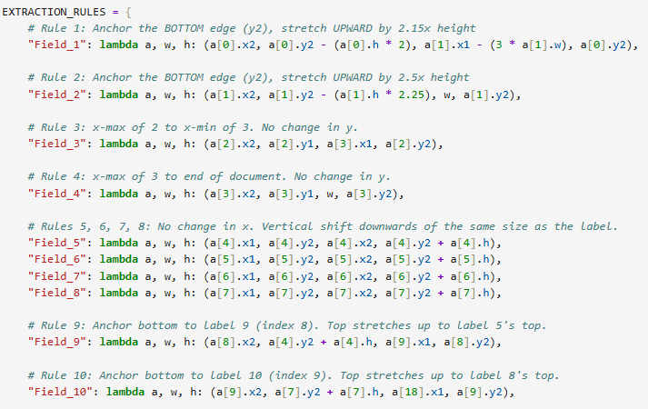
How to set up the system
Identify data fields that are important
Label 20 pieces of data for training of object detection model
Train model
Update rules for offset math

Slide 8
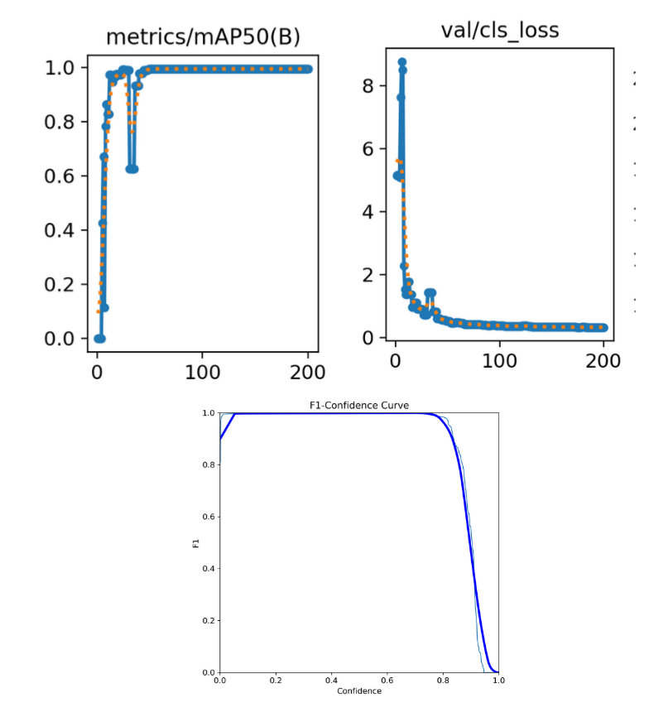
Results
Object Detection Network
.995 mAP50
OCR
EasyOCR
85.40% CRA
58.99% WRA
TrOCR
17.16% CRA
3.83% WRA

Slide 9

Discussion
Object Detection – Great
OCR
EasyOCR – Great could finetuning
TrOCR – Disappointing but why?
Maybe signatures are not meant to be translated
Lightweight systems not meant for cursive handwritten documents?

Slide 10
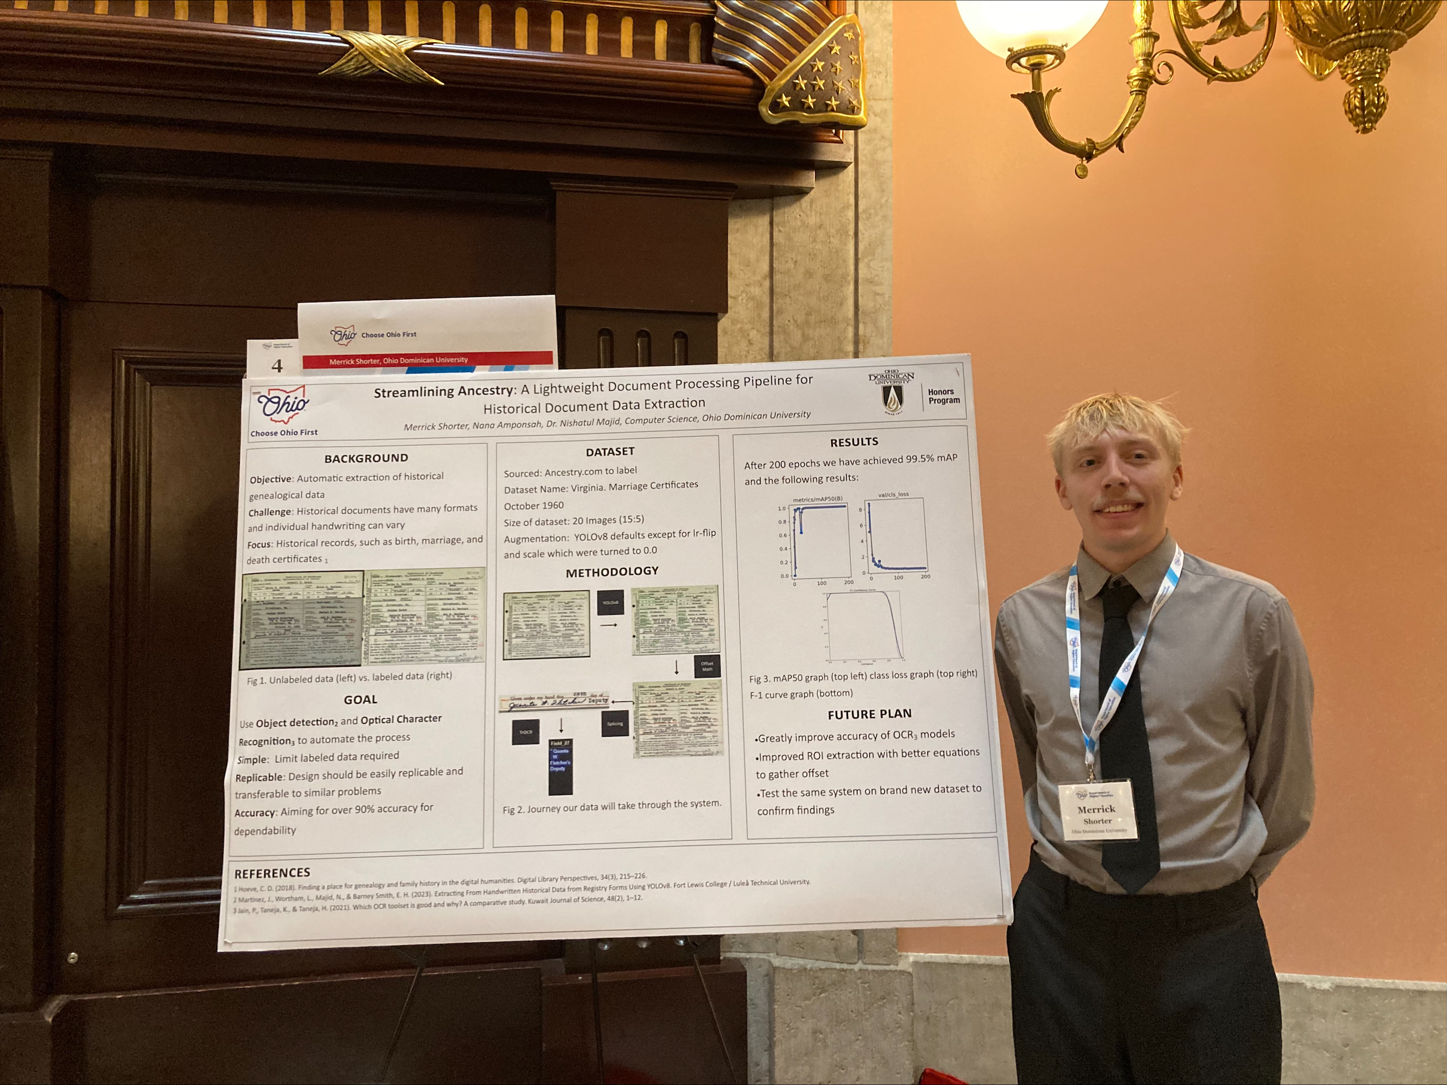
Further research
Post Processing system to clean the data to bring WRA closer to CRA
Minimal fine tuning for OCR models to learn handwriting styles
Test system on many different document types
Interface with Familysearch/Ancestry
Presenting my work at the
Choose Ohio First Scholar Showcase February 2026

Slide 11
Questions

